Slide 1
VISIT - How to visualize IBAMR Data

Slide 2
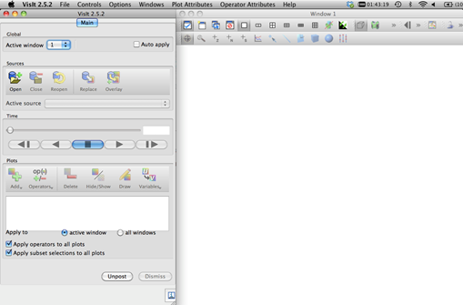
Download Visit, and open it.
https://wci.llnl.gov/simulation/computer-codes/visit/downloads

Slide 3
Get some sample data
https://drive.google.com/open?id=1thvMjhnjRB5gNtvCPoCX8T85-UShohyl
This data is for a 2D simulation of flow past a triangle.

Slide 4
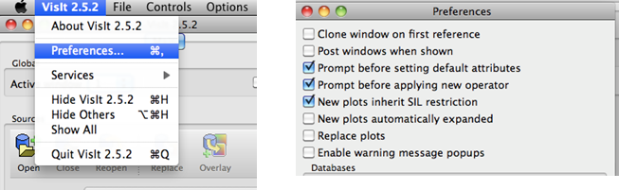
Set some preferences
Next click on the Visit X.X.X next to File and click on Preferences and then UNCHECK the box that reads Enable Warning Message Popups. (The reason for this is because when we start saving movies, a pop-up will spring up every time-step, which quite frankly can gets rather annoying).

Slide 5
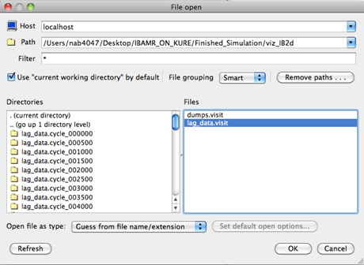
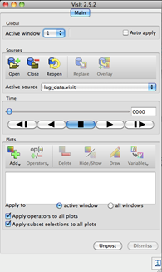
Open the boundary data
Now let’s begin throwing in our data! The first thing we need do open is the geometry files, i.e., the lag_data.visit files. To do this click the open icon, and enter the directory pathway pointing to the sample data file.

Slide 6
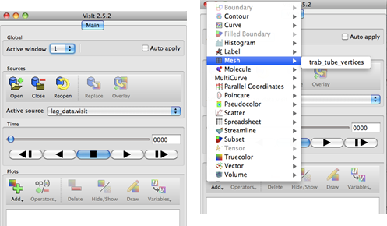
Open the boundary data
Once you click ok, it will return to what is a blank screen. All we did so far was open the file – we need to tell it to draw the Lagrangian points!
To do this first click the Add button and then click on cones2d_512_vertices under the mesh option. (Note that this file was called trab_tube.vertices in the screen shot).

Slide 7
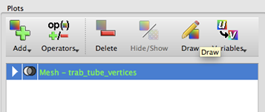
Plot the boundary
You will probably also notice that even though we opened the Lagrangian point file and added the mesh in Visit, nothing has shown up. Well now we will finally draw the geometry. To do this, just click on the mesh- cones2d_512 part and click on Draw.

Slide 8
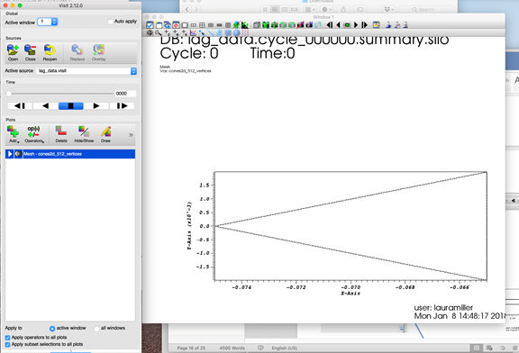
Now you should see the boundary

Slide 9
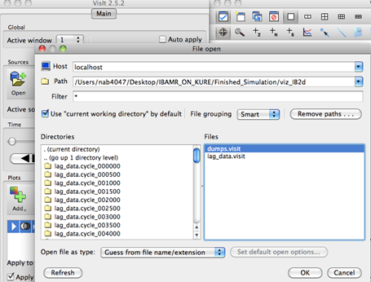
Open the velocity data
First we need to open the data file called dumps.visit, which contains all dynamical information from the simulation. We open this file in a similar manner to how we opened the lag_data.visit file earlier. Click the open tab, and then click the dumps.visit file and ok.

Slide 10
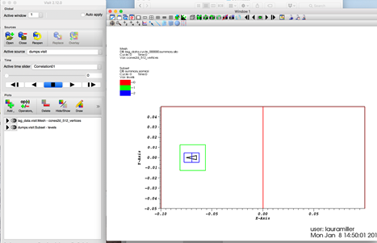
You should see the following
You will now see colored boxes that show up are large regions that involve different levels of the adaptive mesh. If you play the simulation now, you still won’t see any interesting dynamics, but you can see how different levels of the adaptive mesh refinement change to capture better resolution during the course of the simulation in certain areas. However, these boxes will get in the way of seeing a lot of the dynamics, so click of the Hide/Show button to hide them.

Slide 11
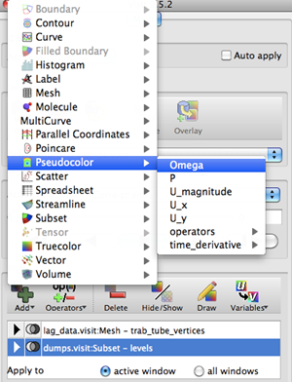
Plot the vorticity
First we will open the vorticity data and plot a color-map for each time-step. To do this make sure the Active Source is dumps.visit is and then click on Add and hover over Pseudocolor and click on Omega for the vorticity colormap. Note: The other items in the list under Pseudocolor are other possible color-maps that are possible, but you can only really visualize one at a time.
Possible colormaps in order:
-Vorticity
-Pressure
-Magnitude of Velocity
-X-Component of Velocity
-Y-Component of Velocity

Slide 12
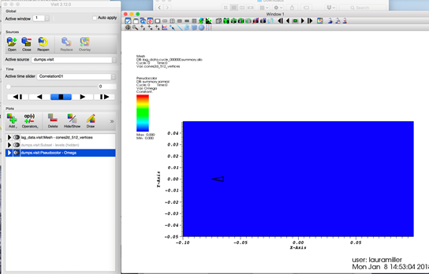
Draw the vorticity
Now click on dumps.visit:Pseudocolor-Omega and click Draw. You should now see

Slide 13
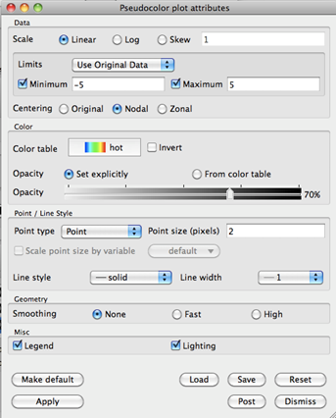
Customize vorticity
To customize the vorticity color-map, double-click on dumps.visit:Pseudocolor-Omega . We will now change a few features in the window that opens.
Change Minimum and Maximum values to -5 and 5, respectively. These are just approximate values, you can change them to see how the colormap is affected. Basically it says if vorticity is ever higher than 5 or less than -5, the colormap only goes up to 5 or -5 as the highest and lowest values.
Click the Nodal option – this should reduce the amount of noisiness around the boundaries a little.
Change the Opacity to 70% (or don’t change it). Reducing the Opacity from 100% to something less helps see the velocity vectors better.

Slide 14
Play the simulation
Now click Apply and press the Play button and watch the simulation! You should see some vortices form behind the cone.
Note that the other color-maps have similar options you can do. I also want to stress that these are just general guidelines to follow, but are in no way the best chosen values to visualize the data. Play around and try things!
Play button

Slide 15
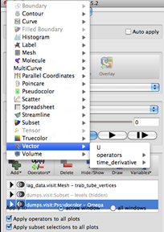
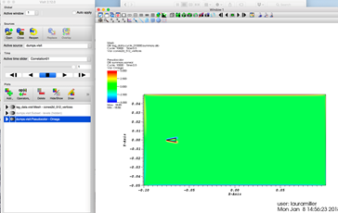
Add velocity vectors
Next we will add the velocity vectors. To do this make sure the Active Source is dumps.visit and then click the Add button and then highlight the choice for Vector and click on U.
Next we will click Draw, like we did for vorticity, and we should see

Slide 16
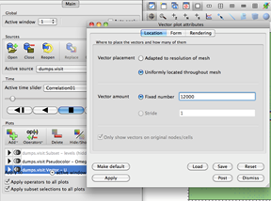
Customize vectors
Next we will have to customize the velocity vectors to see them. Double-click on dumps.visit:Vector-U and a dialog box will open. First we want to click uniformly located throughout mesh add more vectors onto our mesh by clicking fixed number and typing a number, for example 12000 into the box.

Slide 17
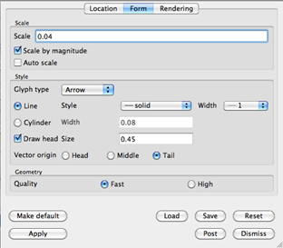
Customize vectors
Next click the tab that reads Form at the top of the dialog box. Inside this tab, you can customized how the vectors are scaled, whether they are scaled at each time-step by the largest velocity or kept constant. Right now I have chosen to Scale as 0.4 (do not use 0.04) and to Scale by Magnitude. The other thing I changed was the Draw head Size to 0.45.

Slide 18
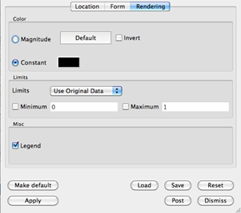
Customize vectors
Next tab over to Rendering and click Constant under the Color section. This will keep all the vectors the same color – this sometimes comes in handy when doing color-plots so the different colors from the color-plots and velocity vectors don’t get confusing or too distracting.

Slide 19
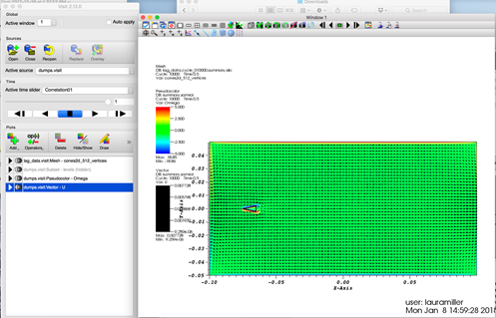
The result
After you click Apply, you should see

Slide 20
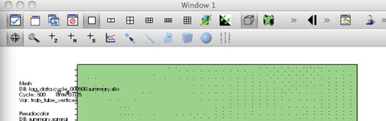
Zoom
You can now watch the simulation by clicking Play. There are many other customizations you can do – this is just the beginning! One thing you might want to do is zoom into the region of interest – namely that around the channel and cavities. To do this just click on the magnifying glass above the geometry window and drag a box over the region of interest and it will zoom in!
Reset the window back to the default window
To zoom into a region you drag your cursor around
Notes:
Reset the window back to the default window

Slide 21
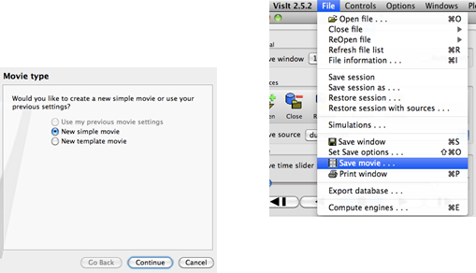
Make a movie
Let’s now talk about saving a movie. To do this go to the File and click on Save Movie. This will bring up another dialog box. At the first screen you will click New simple movie and then click Continue.

Slide 22
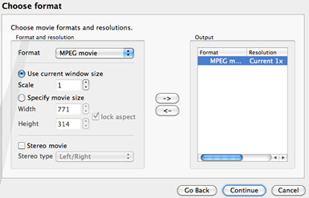
Make a movie
At the next screen we will choose the format to be MPEG Movie and then click the Right arrow, -> , and then click Continue.

Slide 23
Save the movie
Now at the next screen, we have the options of telling it to begin saving the movie at a specific frame, ending at a specific frame, picking the frame rate, and the frame stride (if you want to make a movie out of every other frame, every 5, etc)
Next we can choose what folder the movie gets saved to, as well as you can title the movie. As an example, the movie was saved in the IBAMR_ON_DOGWOOD folder on the Desktop, and was cleverly titled FIRST_SIMULATION_MOVIE.

Slide 24
Suggestions to improve Visit-vorticity
Hide the grid.
Add pseudocolor, omega.
Look at colorplot and pick min/max.
Double click pseudocolor, and define your own min/max.
Try 25% of original min/max.
Underneath, pick Centering: Nodal to smooth

Slide 25
Velocity vectors
Select Vector: U
Double click, uniformly locate throughout the mesh.
Vector amount, set to ~8000.
Rendering tab - Select constant
Limits - Set from 0 to highest magnitude.
Form - can rescale arrows by changing scale.

Slide 26
The boundary
When drawing the boundary, usually you want to plot the vertices.
Increase the pixel size to make lines larger.

Slide 27
Cleaning up the figures
Double click on each item.
Unclick legend if you don’t want.
Go to controls -> annotation
Unclick Database
Unclick User information

Slide 28
Axes
Go to 2D or 3D to modify axes
You can make custom titles and change font style and size
You can change or remove numbers along the axis.

Slide 29
Modify legends
Go to the objects tab.
Click the legend you want to modify
Go to appearance, and unclick draw title and draw min/max.
Click position to move the legend around.
Under “Create New”, you can add text box or other things and move them around.

Slide 30
Save session as
Save your work as a visit session.
Restore session will reopen it.
Restore session with sources allows you to select different data.

Slide 31
Making movies
Save as mpeg is not the best option.
You can save movie, “new simple movie”, then select .PNG or .jpeg and it will save a set of images.
Put the set of images back together as a movie using VirtualDub (free for PC) or Quicktime Pro.

Slide 32
VISIT 3D

Slide 33
3D data
You can find some sample data here:
https://drive.google.com/file/d/12lRoeCrj5SZBlZ3hVg698iIPI9wZs0_W/view?usp=sharing
Note that some of the slides use different data for a 3D pulsing coral.
Unfortunately I don’t have this data.

Slide 34
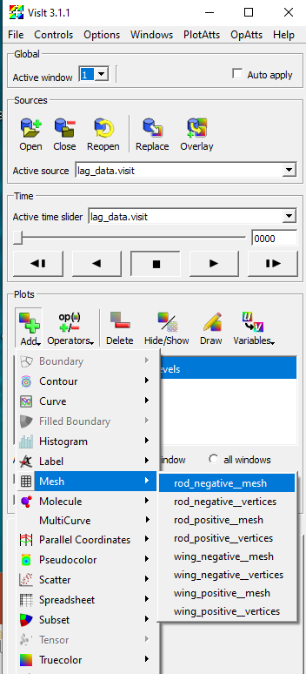
Sample data
This has two time steps for two wings performing a clap and fling.
Each wing consists of a wing and a rod.
You will want to open the four .vertices files.

Slide 35
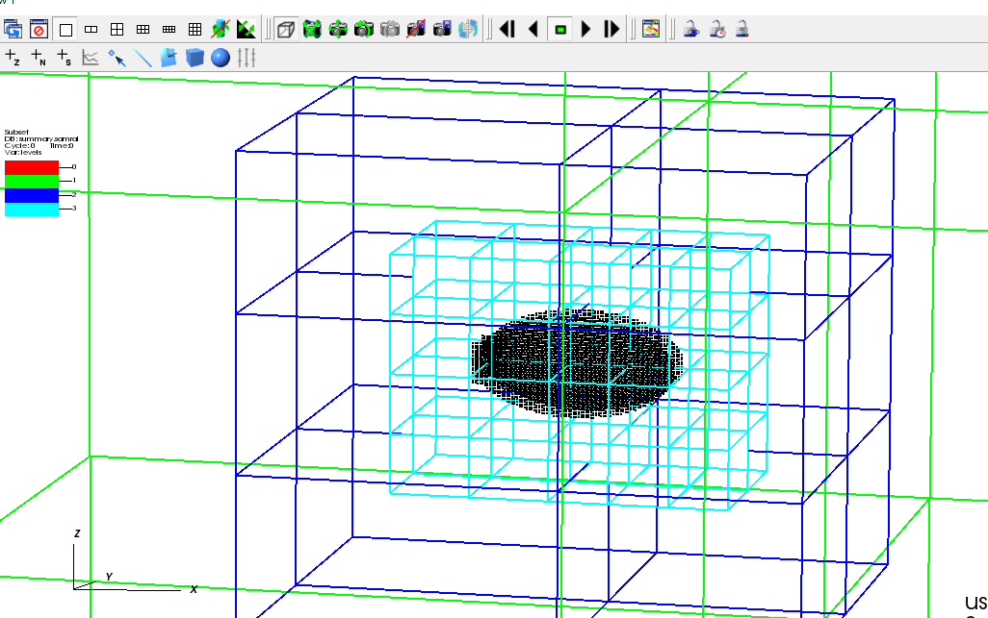
Immersed boundaries
When loading all of the vertices, unclick the legends.
As in 2D:
Plot vertices
Make them bigger by increasing the pixel size (use the mesh attributes to do this)

Slide 36
Vorticity - 3D View
add contour of omega_magnitude
modify the attributes
change the minimum and maximum vorticity as in 2D
modify N levels somewhere between 5 and 10
choose single for contour colors
modify the color - I chose blue
modify the opacity between 10% and 15%
zoom in and modify the camera angle

Slide 37
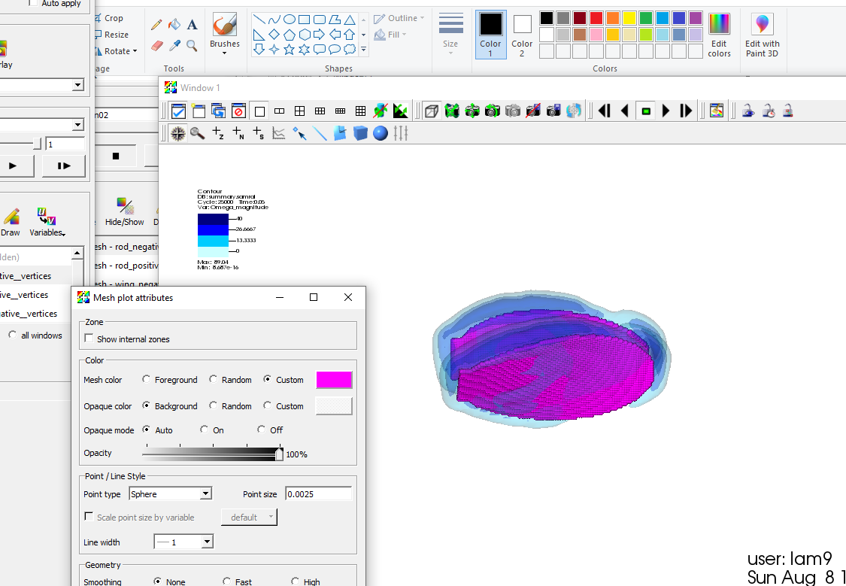

Slide 38
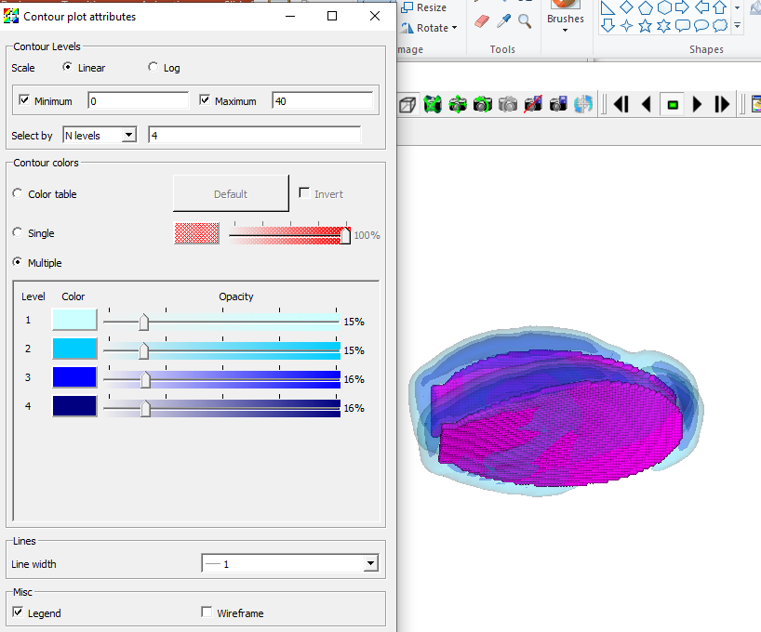

Slide 39
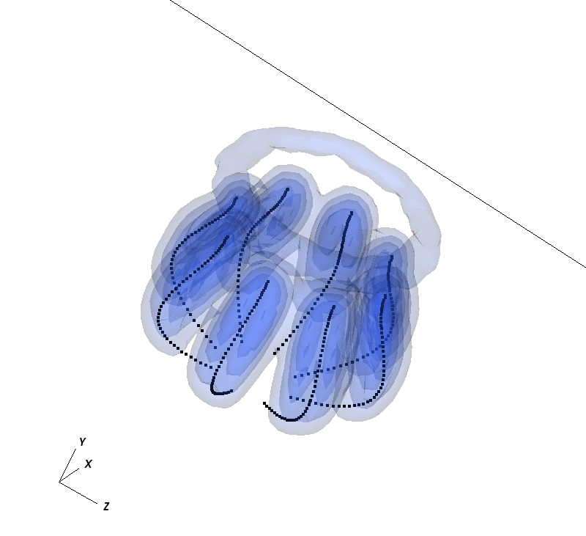
Vorticity - 3D view
Example:
(this simulation is on a very coarse grid)

Slide 40
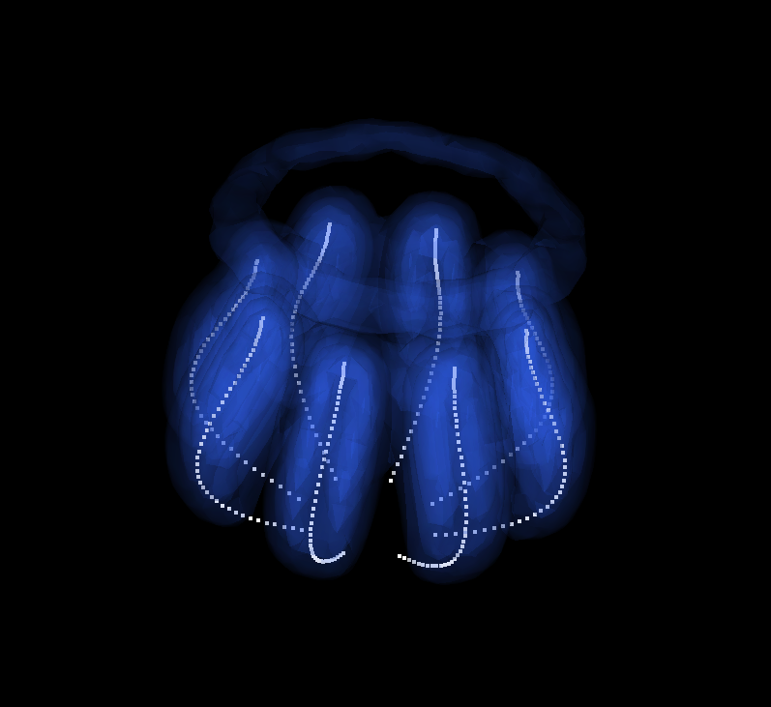
Vorticity - 3D view
Example: Playing with the colors (controls -> annotation) can modify things a lot

Slide 41
Adding velocity vectors on a slice
add vector of U
modify the attributes
location: change the number of vectors (fixed number = 4000) and place them uniformly
form: change form quality to high
rendering: change color and set min and max values based on data

Slide 42
to make a slice
deselect apply operators to all plots and apply subset selections to all plots in the main window
highlight the added Vector - U
choose operator attributes -> selection -> slicing -> slice
slice operator attributes -> choose the slice you want

Slide 43
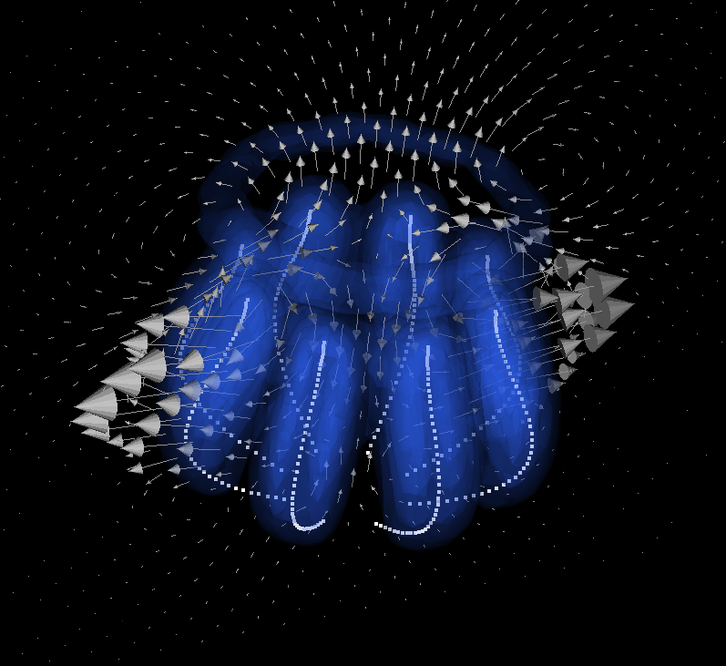
Adding velocity vectors on a slice
Example:

Slide 44
Other things on slices
In similar ways you can add other properties on slices - here is an example of looking at the vorticity on the same slice as the velocity field
Once again you just apply the operator attribute to the desired field (here I also modified some of the plot attributes of the vorticity field.)

Slide 45
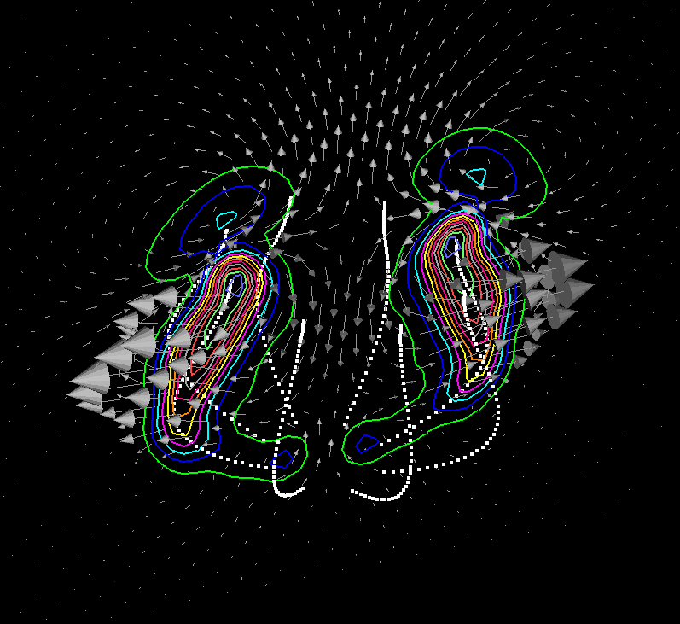
Other things on slices
Example of vorticity contours on a slice:

